Slide 1
AVR Microcontroller
Microprocessor Course
Chapter 16
PWM PROGRAMMING AND
DC MOTOR CONTROL IN AVR
Bahman 1397 (Version 1.2)

Slide 2
PWM PROGRAMMING AND DC MOTOR CONTROL IN AVR SECTION 16.1 : DC MOTOR INTERFACING AND PWM
DC motors
A direct current (DC) motor is a widely used device that translates electrical pulses into mechanical movement. In the DC motor we have only + and - leads. Connecting them to a DC voltage source moves the motor in one direction. By reversing the polarity, the DC motor will move in the opposite direction. One can easily experiment with the DC motor.
For example, the small fans used in many motherboards to cool the CPU are run by DC motors. When the leads are connected to the + and - voltage source, the DC motor moves. While a stepper motor moves in steps of 1 to 15 degrees, the DC motor moves continuously.
In a stepper motor, if we know the starting position we can easily count the number of steps the motor has moved and calculate the final position of the motor. This is not possible with a DC motor.

Slide 3
PWM PROGRAMMING AND DC MOTOR CONTROL IN AVR SECTION 16.1 : DC MOTOR INTERFACING AND PWM
DC motors
The maximum speed of a DC motor is indicated in rpm and is given in the data sheet. The DC motor has two rpms: no-load and loaded. The manufacturer's datasheet gives the no-load rpm. The no-load rpm can be from a few thousand to tens of thousands.
The rpm is reduced when moving a load and it decreases as the load is increased. For example, a drill turning a screw has a much lower rpm speed than when it is in the no-load situation. DC motors also have voltage and current ratings.
The nominal voltage is the voltage for that motor under normal conditions, and can be from 1 to 150 V, depending on the motor. As we increase the voltage, the rpm goes up. The current rating is the current consumption when the nominal voltage is applied with no load, and can be from 25 mA to a few amps.

Slide 4
PWM PROGRAMMING AND DC MOTOR CONTROL IN AVR SECTION 16.1 : DC MOTOR INTERFACING AND PWM
DC motors
As the load increases, the rpm is decreased, unless the current or voltage provided to the motor is increased, which in turn increases the torque.
With a fixed voltage, as the load increases, the current (power) consumption of a DC motor is increased. If we overload the motor it will stall, and that can damage the motor due to the heat generated by high current consumption.

Slide 5
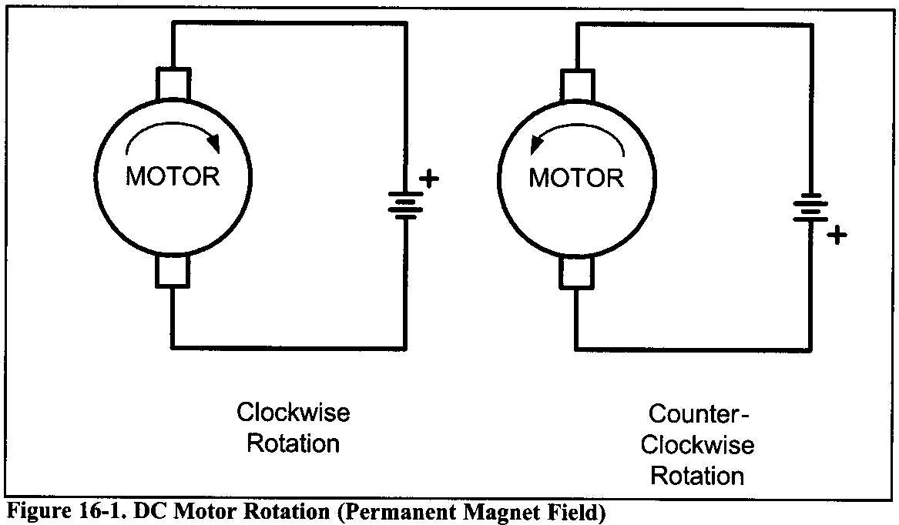
PWM PROGRAMMING AND DC MOTOR CONTROL IN AVR SECTION 16.1 : DC MOTOR INTERFACING AND PWM
Unidirectional control
Figure 16-1 shows the DC motor rotation for clockwise (CW) and counterclockwise (CCW) rotations.

Slide 6
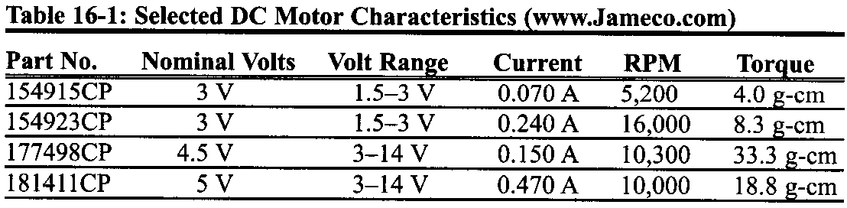
PWM PROGRAMMING AND DC MOTOR CONTROL IN AVR SECTION 16.1 : DC MOTOR INTERFACING AND PWM
See Table 16-1 for selected DC motors

Slide 7
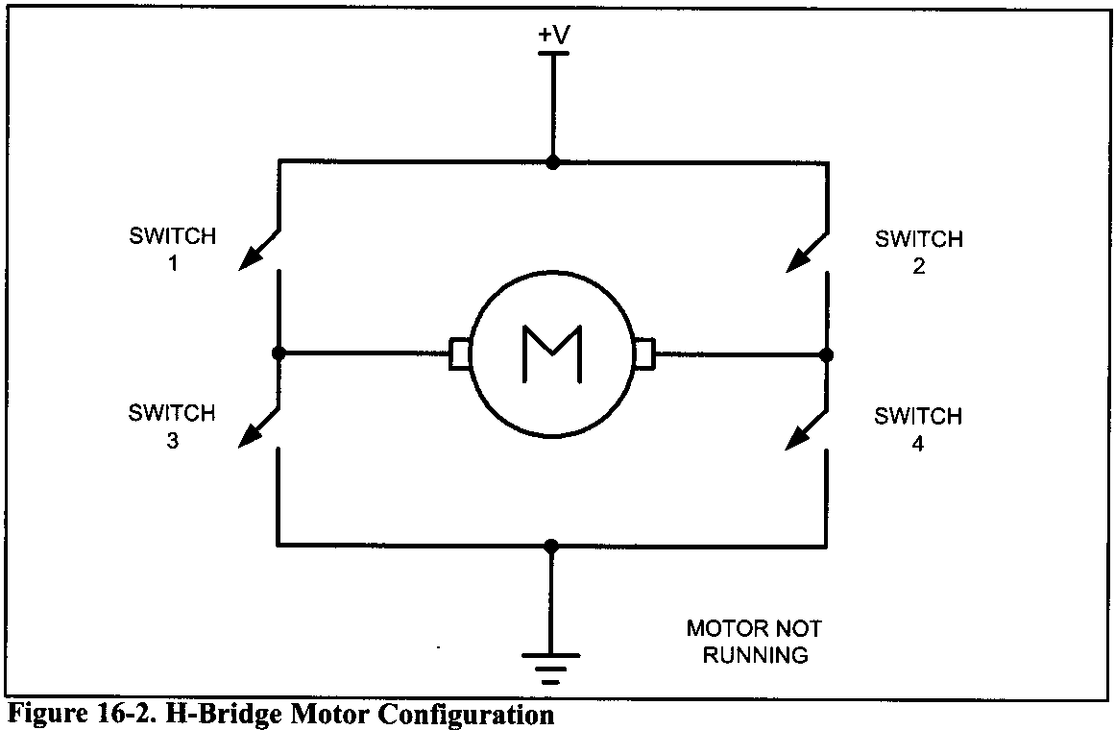
PWM PROGRAMMING AND DC MOTOR CONTROL IN AVR SECTION 16.1 : DC MOTOR INTERFACING AND PWM
Bidirectional control
With the help of relays or some specially designed chips we can change the direction of the DC motor rotation. Figures 16-2 through 16-4 show the basic concepts of H-bridge control of DC motors.
Figure 16-2 shows the connection of an H-bridge using simple switches. All the switches are open, which does not allow the motor to turn.

Slide 8
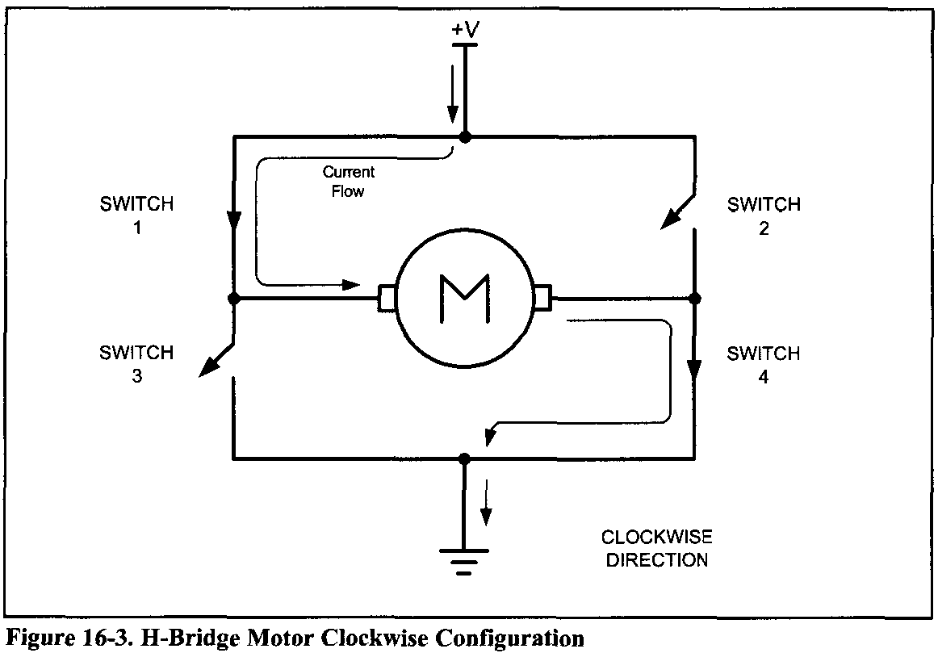
PWM PROGRAMMING AND DC MOTOR CONTROL IN AVR SECTION 16.1 : DC MOTOR INTERFACING AND PWM
Figure 16-3 shows the switch configuration for turning the motor in one direction. When switches 1 and 4 are closed, current is allowed to pass through the motor.

Slide 9
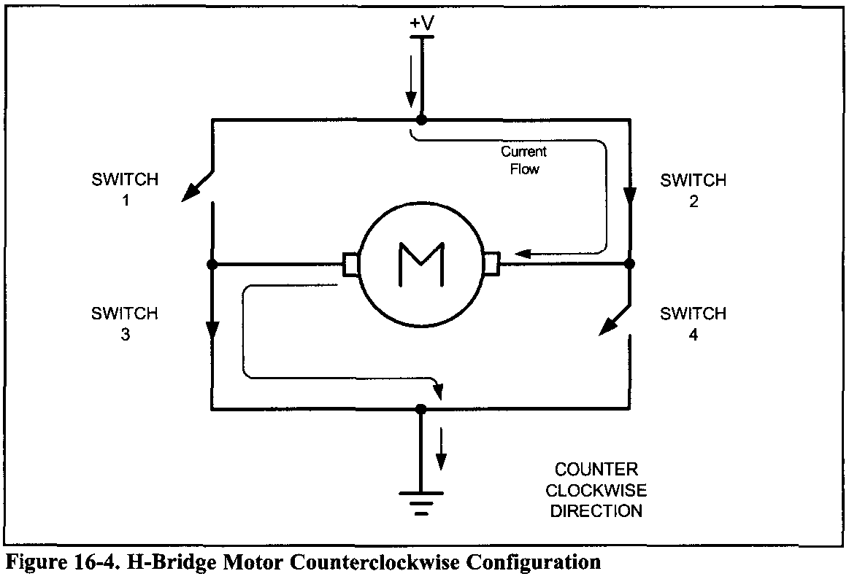
PWM PROGRAMMING AND DC MOTOR CONTROL IN AVR SECTION 16.1 : DC MOTOR INTERFACING AND PWM
Figure 16-4 shows the switch configuration for turning the motor in the opposite direction from the configuration of Figure 16-3. When switches 2 and 3 are closed, current is allowed to pass through the motor.

Slide 10
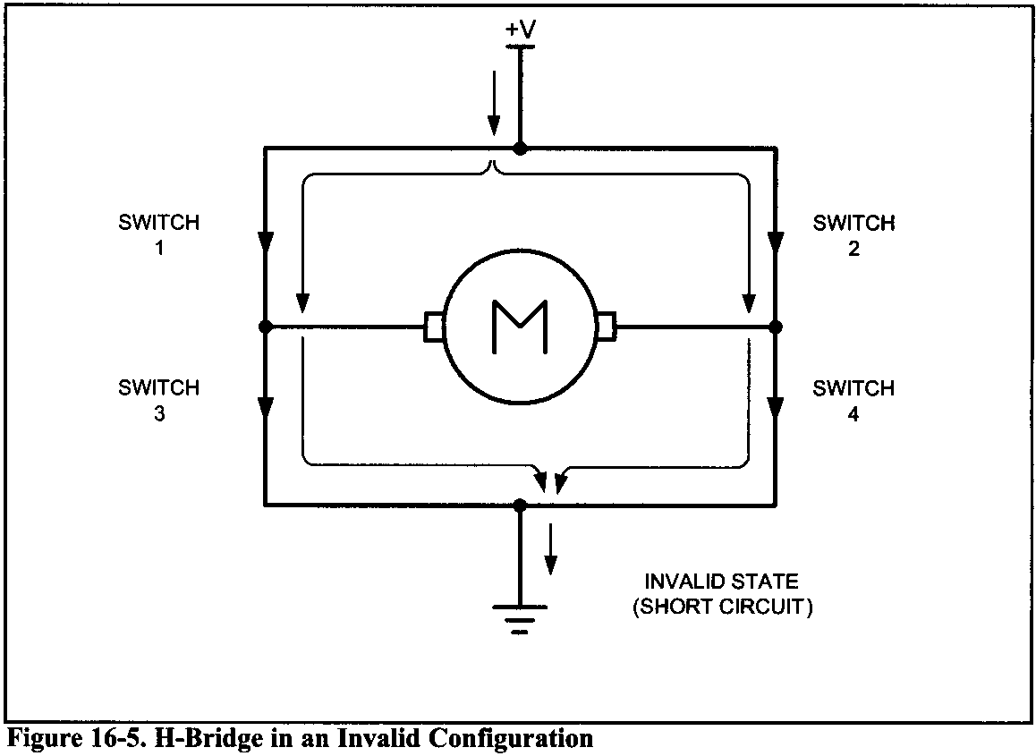
PWM PROGRAMMING AND DC MOTOR CONTROL IN AVR SECTION 16.1 : DC MOTOR INTERFACING AND PWM
Figure 16-5 shows an invalid configuration. Current flows directly to ground, creating a short circuit. The same effect occurs when switches 1 and 3 are closed or switches 2 and 4 are closed.

Slide 11
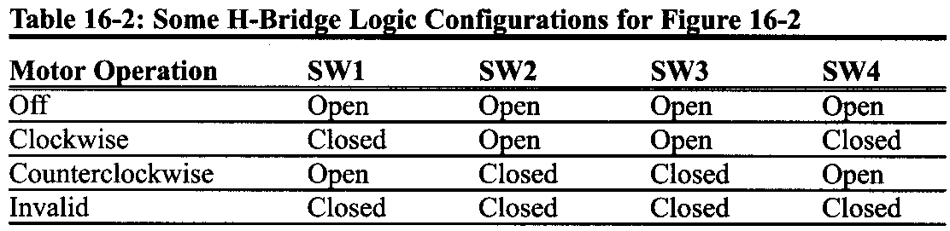
PWM PROGRAMMING AND DC MOTOR CONTROL IN AVR SECTION 16.1 : DC MOTOR INTERFACING AND PWM
Table 16-2 shows some of the logic configurations for the H-bridge design. H-bridge control can be created using relays, transistors, or a single IC solution such as the L298. When using relays and transistors, you must ensure that invalid configurations do not occur.

Slide 12
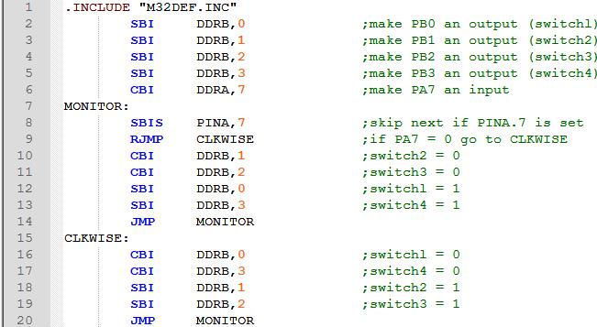
PWM PROGRAMMING AND DC MOTOR CONTROL IN AVR SECTION 16.1 : DC MOTOR INTERFACING AND PWM
Example 16-1
A switch is connected to pin PA7 (PORTA.7). Using a simulator, write a program to simulate the H-bridge in Table 16-2. We must perform the following: (a) If PA7 = 0, the DC motor moves clockwise. (b) If PA7 = 1, the DC motor moves counterclockwise.
Solution:

Slide 13
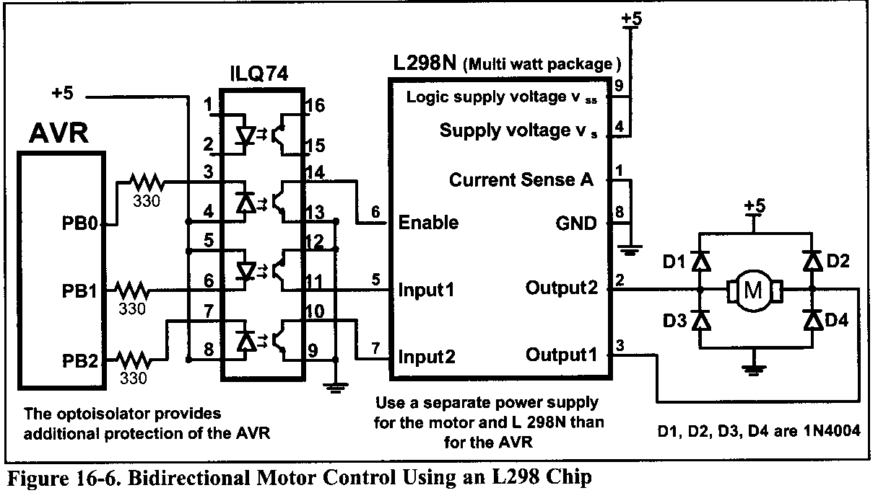
PWM PROGRAMMING AND DC MOTOR CONTROL IN AVR SECTION 16.1 : DC MOTOR INTERFACING AND PWM
Figure 16-6 shows the connection of the L298 to an AVR. Be aware that the L298 will generate heat during operation. For sustained operation of the motor, use a heat sink. Example 16-2 shows control of the L298.

Slide 14
PWM PROGRAMMING AND DC MOTOR CONTROL IN AVR SECTION 16.1 : DC MOTOR INTERFACING AND PWM
DC motor control with optoisolator
As we discussed in Chapter 14, the optoisolator is indispensable in many motor control applications. Figures 16-6 through 16-8 show the connections to a simple DC motor using an optoisolator. Notice that the AVR is protected from EMI created by motor brushes by using an optoisolator and a separate power supply.

Slide 15
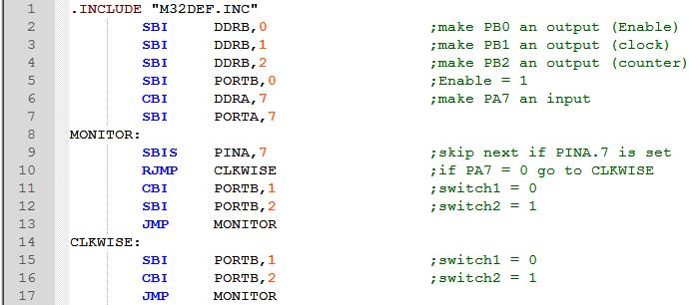
PWM PROGRAMMING AND DC MOTOR CONTROL IN AVR SECTION 16.1 : DC MOTOR INTERFACING AND PWM
Example 16-2
Figure 16-6 shows the connection of an L298. Add a switch to pin PA7 (PORTA.7). Write a program to monitor the status of SW and perform the following: (a) If SW = 0, the DC motor moves clockwise. (b) If SW = 1, the DC motor moves counterclockwise.
Solution:

Slide 16
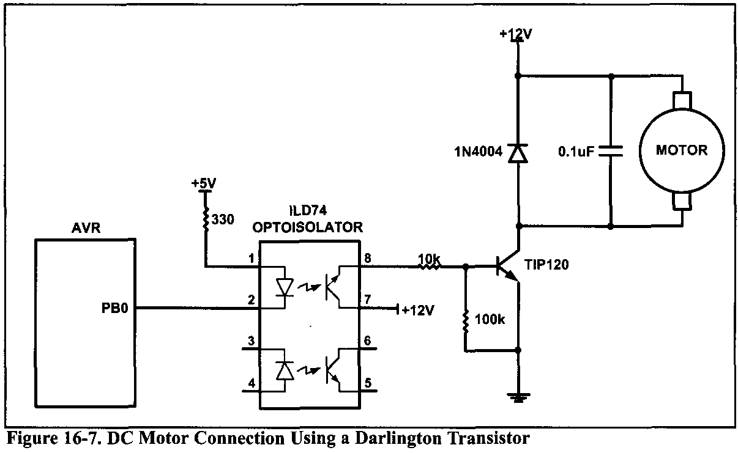
PWM PROGRAMMING AND DC MOTOR CONTROL IN AVR SECTION 16.1 : DC MOTOR INTERFACING AND PWM
Figure 16-7 shows the connection of a bipolar transistor to a motor. Protection of the control circuit is provided by the optoisolator.

Slide 17
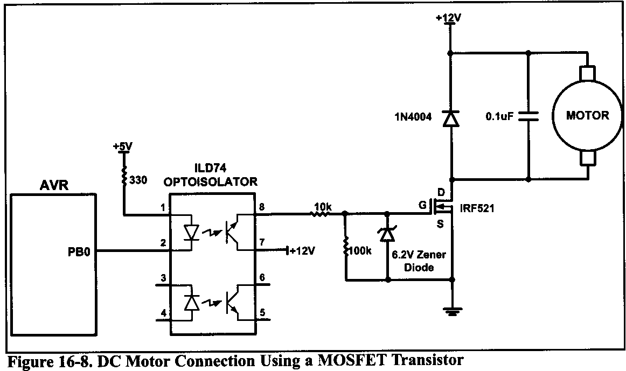
PWM PROGRAMMING AND DC MOTOR CONTROL IN AVR SECTION 16.1 : DC MOTOR INTERFACING AND PWM
The motor and AVR use separate power supplies. The separation of power supplies also allows the use of high-voltage motors. Notice that we use a decoupling capacitor across the motor; this helps reduce the EMI created by the motor. The motor is switched on by clearing bit PB0. The Zener diode is required for the transistor to reduce gate voltage below the rated maximum value.

Slide 18
PWM PROGRAMMING AND DC MOTOR CONTROL IN AVR SECTION 16.1 : DC MOTOR INTERFACING AND PWM
Pulse width modulation (PWM) page 564
The speed of the motor depends on three factors:
load
Voltage
Current
For a given fixed load we can maintain a steady speed by using a method called pulse width modulation (PWM). By changing (modulating) the width of the pulse applied to the DC motor we can increase or decrease the amount of power provided to the motor, thereby increasing or decreasing the motor speed.
PWM is so widely used in DC motor control that some microcontrollers come with the PWM circuitry embedded in the chip. In such microcontrollers all we have to do is load the proper registers with the values of the high and low portions of the desired pulse, and the rest is taken care of by the microcontroller.

Slide 19
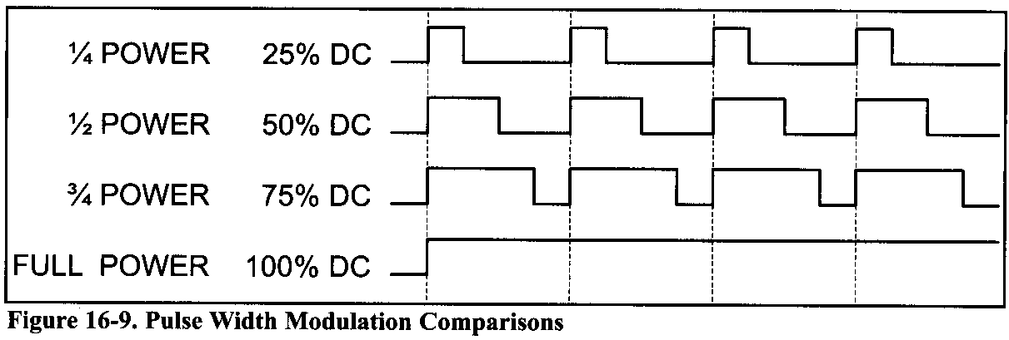
PWM PROGRAMMING AND DC MOTOR CONTROL IN AVR SECTION 16.1 : DC MOTOR INTERFACING AND PWM
The ability to control the speed of the DC motor using PWM is one reason that DC motors are often preferred over AC motors. AC motor speed is dictated by the AC frequency of the voltage applied to the motor and the frequency is generally fixed. As a result, we cannot control the speed of the AC motor when the load is increased.

Slide 20
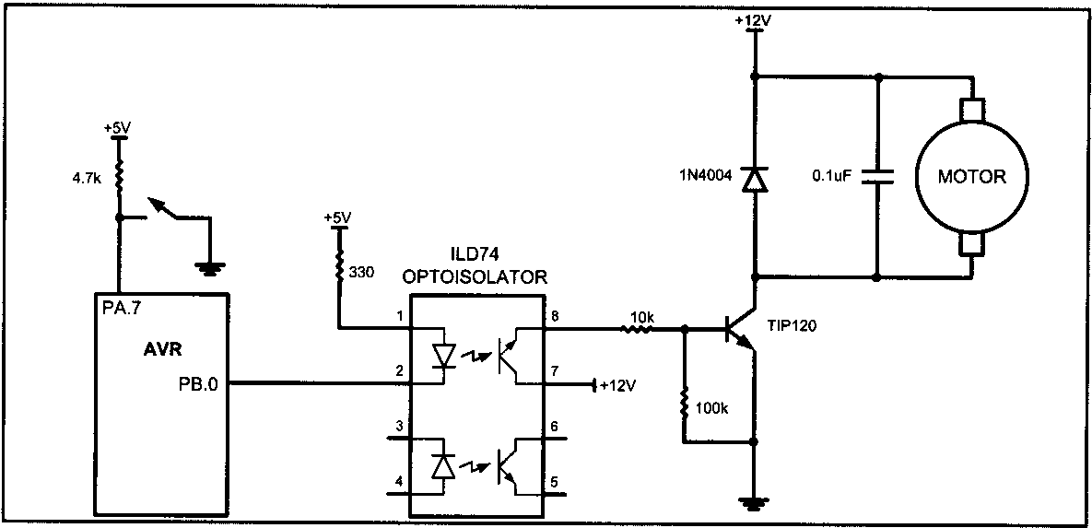
PWM PROGRAMMING AND DC MOTOR CONTROL IN AVR SECTION 16.1 : DC MOTOR INTERFACING AND PWM
Example 16-3
Refer to the figure in this example. Write a program to monitor the status of the switch and perform the following: (a) If PORTA.7 = 1, the DC motor moves with 25% duty cycle pulse. (11) If PORTA.7 = 0, the DC motor moves with 50% duty cycle pulse.

Slide 21
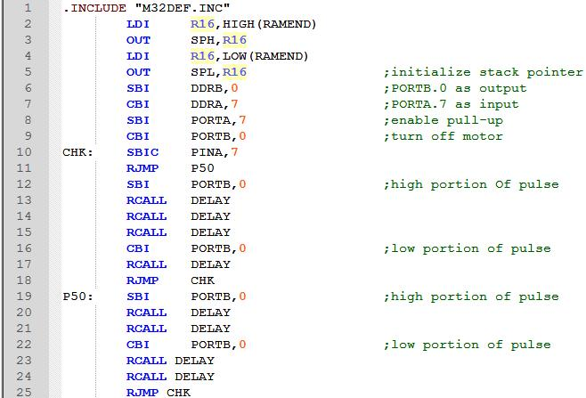
PWM PROGRAMMING AND DC MOTOR CONTROL IN AVR SECTION 16.1 : DC MOTOR INTERFACING AND PWM
Solution:

Slide 22
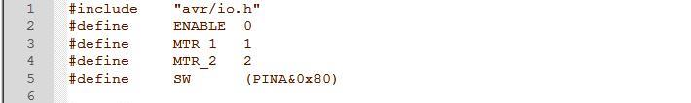
PWM PROGRAMMING AND DC MOTOR CONTROL IN AVR SECTION 16.1 : DC MOTOR INTERFACING AND PWM
Example 16-4 (C version of Example 16-2)
Refer to Figure 16-6 for connection of the motor. A switch is connected to pin PA7. Write a C program to monitor the status of SW and perform the following: (a) If SW = 0, the DC motor moves clockwise.
(b) If SW = 1, the DC motor moves counterclockwise.
Solution:

Slide 23
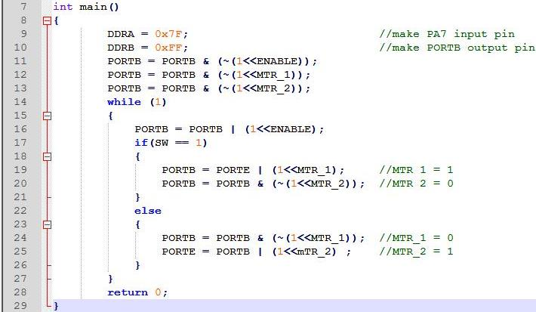
PWM PROGRAMMING AND DC MOTOR CONTROL IN AVR SECTION 16.1 : DC MOTOR INTERFACING AND PWM

Slide 24

PWM PROGRAMMING AND DC MOTOR CONTROL IN AVR SECTION 16.1 : DC MOTOR INTERFACING AND PWM
Example 16-5 (C version of Example 16-3)
Refer to the figure in this example. Write a C program to monitor the status of SW and perform the following:
If SW = 0, the DC motor moves with 50% duty cycle pulse.
If SW = 1, the DC motor moves with 25% duty cycle pulse.
Solution:

Slide 25
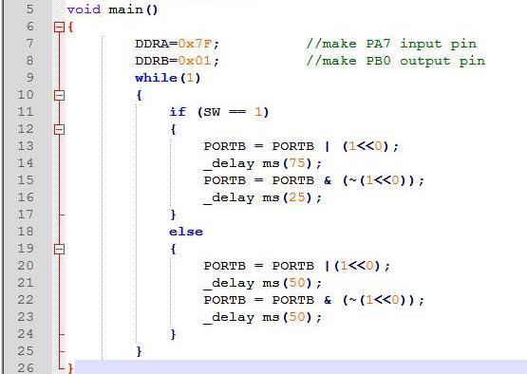
PWM PROGRAMMING AND DC MOTOR CONTROL IN AVR SECTION 16.1 : DC MOTOR INTERFACING AND PWM

Slide 26
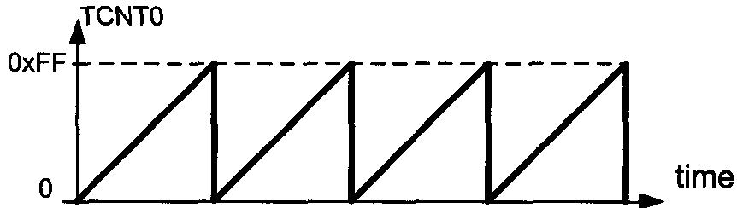
PWM PROGRAMMING AND DC MOTOR CONTROL IN AVR SECTION 16.2: PWM MODES IN 8-BIT TIMERS
PWM MODES IN 8-BIT TIMERS
In this section we discuss the PWM feature of the AVR. The ATmega32 comes with three timers, which can be used as wave generators. The advantage of using the built-in PWM feature of the AVR is that it gives us the option of programming the period and duty cycle, therefore relieving the CPU to do other important things.
Fast PWM mode
In the Fast PWM, the counter counts like it does in the Normal mode. After the timer is started, it starts to count up. It counts up until it reaches its limit of 0xFF. When it rolls over from 0xFF to 00, it sets HIGH the TOV0 flag.

Slide 27
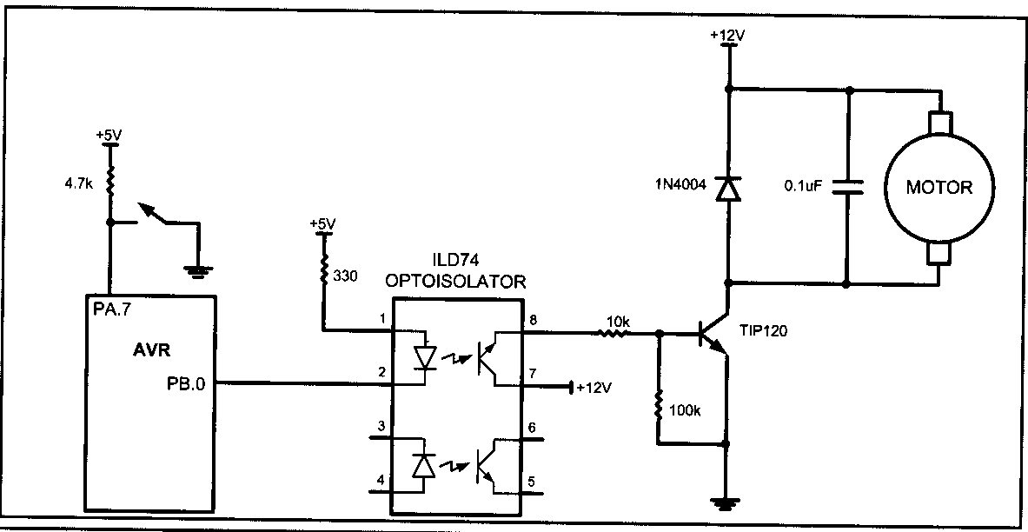
PWM PROGRAMMING AND DC MOTOR CONTROL IN AVR SECTION 16.1 : DC MOTOR INTERFACING AND PWM

Slide 28
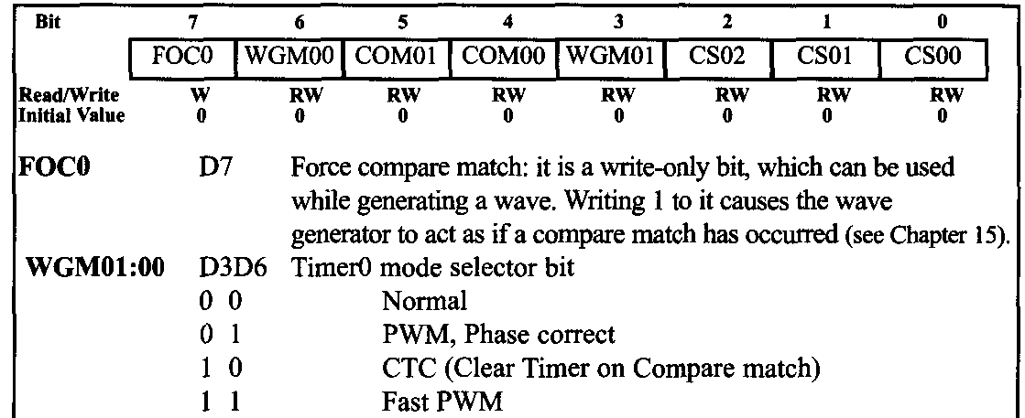
PWM PROGRAMMING AND DC MOTOR CONTROL IN AVR SECTION 16.2: PWM MODES IN 8-BIT TIMERS
In Figure 16-12 you see the reaction of the waveform generator when compare match occurs while the timer is in Fast PWM mode.

Slide 29
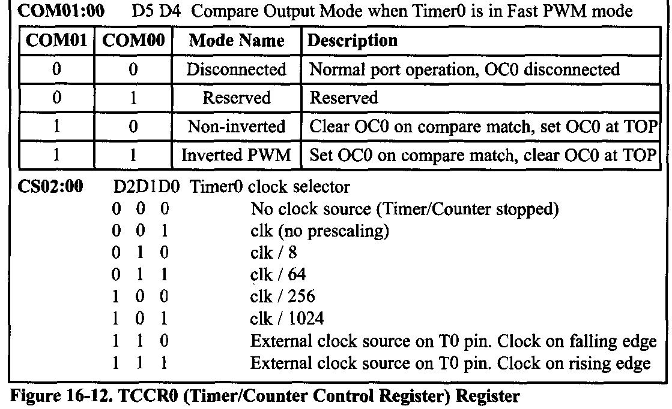
PWM PROGRAMMING AND DC MOTOR CONTROL IN AVR SECTION 16.2: PWM MODES IN 8-BIT TIMERS

Slide 30
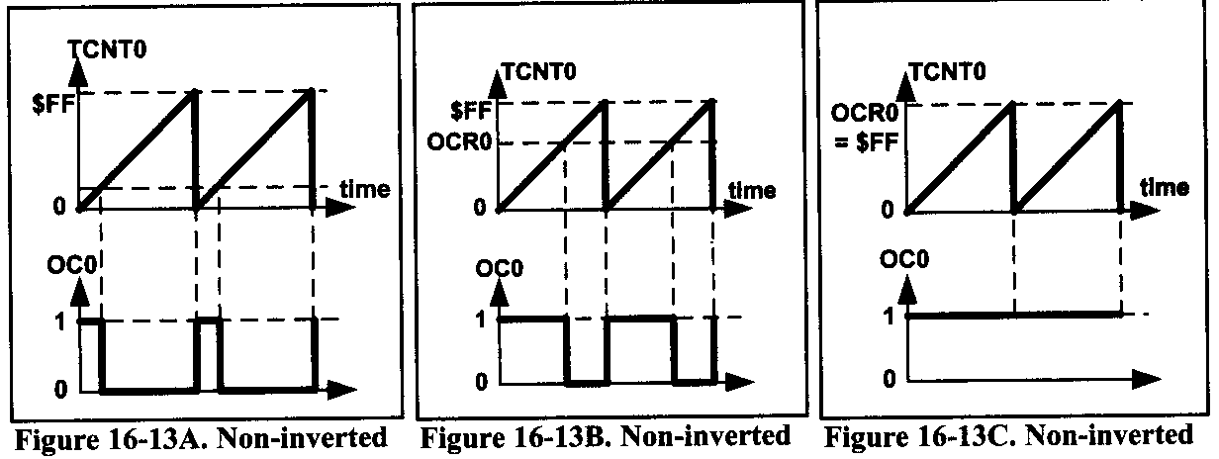
PWM PROGRAMMING AND DC MOTOR CONTROL IN AVR SECTION 16.2: PWM MODES IN 8-BIT TIMERS
When COM01:00=00 the OC0 pin operates as an I/O port. When COM01:00=10, the waveform generator clears the OC0 pin whenever compare match occurs, and sets it at top. This mode is called non-inverted PWM. See Figures16-13A through 16-13C. As you see from these figures, in the non-inverted PWM, the duty cycle of the generated wave increases when the value of OCR0 increase.

Slide 31
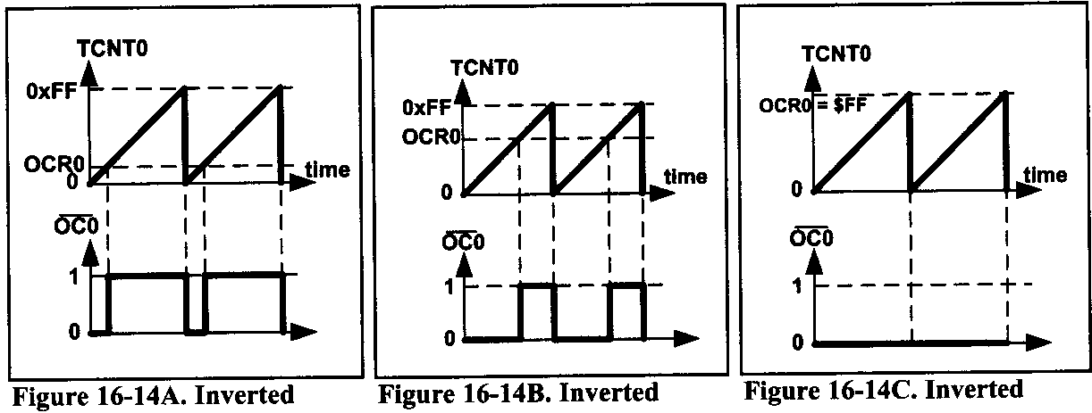
PWM PROGRAMMING AND DC MOTOR CONTROL IN AVR SECTION 16.2: PWM MODES IN 8-BIT TIMERS
When COM01:00=11, the waveform generator sets the OC0 pin whenever compare match occurs, and clears it at top. This mode is referred as inverted PWM mode. See Figures 16-14A through 16-14C. As you see, in the inverted PWM mode when the value of OCR0 increases, the duty cycle of the generated wave decreases.

Slide 32
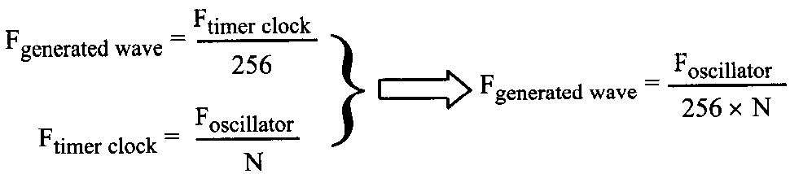
PWM PROGRAMMING AND DC MOTOR CONTROL IN AVR SECTION 16.2: PWM MODES IN 8-BIT TIMERS
Frequency of the generated wave in Fast PWM mode
In Fast PWM mode, the timer counts from 0 to top (0xFF in 8-bit counters) and then rolls over. So, the frequency of the generated wave is 1/256 of the frequency of timer clock. So, in 8-bit timers the frequency of the generated wave can be calculated as follows (N is determined by the prescaler):

Slide 33


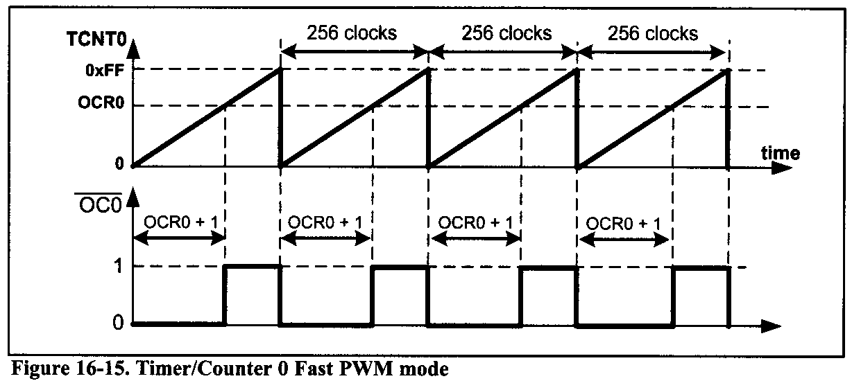
PWM PROGRAMMING AND DC MOTOR CONTROL IN AVR SECTION 16.2: PWM MODES IN 8-BIT TIMERS
For non Inverted mode
For Inverted mode
Notes:
The duty cycle of the generated mode can be determined using the OCR0 register. When COM01:00 = 10 (in non-inverted mode), the bigger OCR0 value results in a bigger duty cycle; When OCR0 = 255, the OC0 is 256 clocks out of 256 clocks, which means always high (duty cycle = 100%). Generally speaking, the OC0 is high, for a total of OCR0 + 1 clocks. See Figure 16-15. So, the duty cycle can be calculated using the following formula in non-inverted mode:

Slide 34
PWM PROGRAMMING AND DC MOTOR CONTROL IN AVR SECTION 16.2: PWM MODES IN 8-BIT TIMERS
Example 16-6
To generate a wave with duty cycle of 75% in non-inverted mode, calculate the OCR0.
Solution:
75=(OCR0+1)×100/256 ⇒ OCR0+1=75×256/100=192 ⇒ OCR0 = 191

Slide 35
PWM PROGRAMMING AND DC MOTOR CONTROL IN AVR SECTION 16.2: PWM MODES IN 8-BIT TIMERS
Example 16-7
Find the value for TCCR0 to initialize Timer0 for Fast PWM mode, non-inverted PWM wave generator, and no prescaler.
Solution:
WGM01:00-11=Fast PWM mode
COM01:00=10=Non-inverted PWM
TCCR0=CS02:00=001=No prescaler

Slide 36
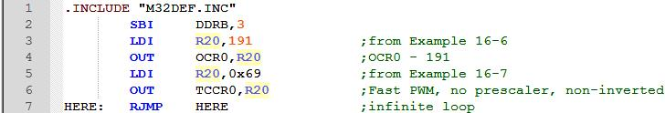
PWM PROGRAMMING AND DC MOTOR CONTROL IN AVR SECTION 16.2: PWM MODES IN 8-BIT TIMERS
Example 16-8
Assuming XTAL = 8 MHz, using non-inverted mode, write a program that generates a wave with frequency of 31,250 Hz and duty cycle of 75%.
Solution:
31,250=8M/(256 × N) ⇒ N=8M/(31,250×256)=1 ⇒ N=1 ⇒ No prescaler
Notice that instead of the infinite loop we can use the CPU to perform other things.

Slide 37
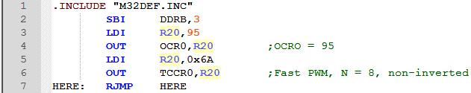
PWM PROGRAMMING AND DC MOTOR CONTROL IN AVR SECTION 16.2: PWM MODES IN 8-BIT TIMERS
Example 16-9
Assuming XTAL = 8 MHz, using non-inverted mode, write a program that generates a wave with frequency of 3906.25 Hz and duty cycle of 37.5%.
Solution:
3906.25=8M/(256×N) ⇒ N=8M/(3906.25×256)=8 ⇒ the prescaler value=8 37.5=100×(OCR0+1)/256 ⇒ OCR0+1=(256×37.5)/100=96 OCR0=95

Slide 38
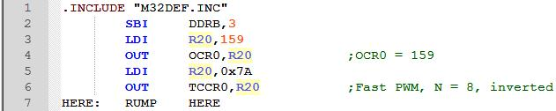
PWM PROGRAMMING AND DC MOTOR CONTROL IN AVR SECTION 16.2: PWM MODES IN 8-BIT TIMERS
Example 16-10
Rewrite Example 16-9 using inverted mode.
Solution:
37.5=100×(255–OCR0)/256 ⇒ 255–OCR0=(256×37.5)/100=96 ⇒ OCR0 =159

Slide 39
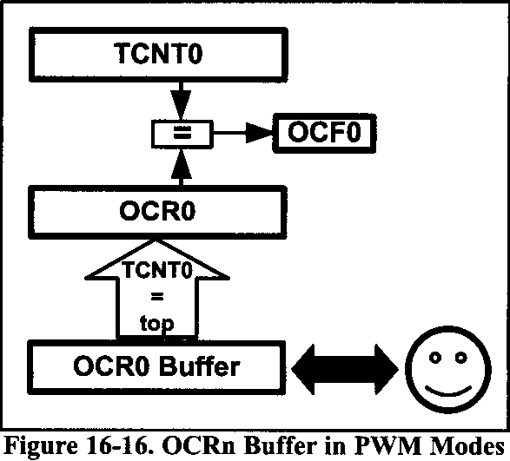
PWM PROGRAMMING AND DC MOTOR CONTROL IN AVR SECTION 16.2: PWM MODES IN 8-BIT TIMERS
Loading values into the OCRx register in PWM modes
In the non-PWM modes (CTC mode and Normal), when we load a value into the OCR0 register, the value will be loaded instantly into the OCR0 register,
But in the PWM modes, there is a buffer between us and the OCR0 register. When we read/write a value from/into the OCR0 we are dealing with the buffer. The contents of the buffer will be loaded into the OCR0 register only when the TCNT0 reaches to its top most value.

Slide 40
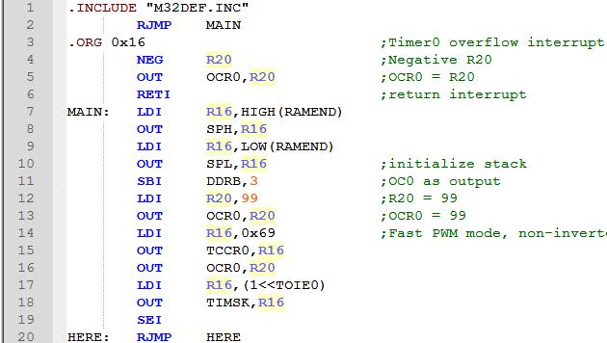
PWM PROGRAMMING AND DC MOTOR CONTROL IN AVR SECTION 16.2: PWM MODES IN 8-BIT TIMERS
Example 16-11
Draw the wave generated by the following program. Assume XTAL = 1 MHz.

Slide 41
PWM PROGRAMMING AND DC MOTOR CONTROL IN AVR SECTION 16.2: PWM MODES IN 8-BIT TIMERS
Solution:
The wave generator is in non-inverted Fast PWM mode, which means that on compare match the OC0 pin will be set high. The OCR0 register is loaded with 99; so compare match occurs when TCNT0 reaches 99. When the timer reaches the top value and over-flows, the interrupt request occurs, and the OCR0 buffer is loaded with 157 (the two's complement of 99). The next time that the timer reaches the top value, the contents of the OCR0 buffer (157) will be loaded into the OCR0 register. Then the second interrupt occurs and the OCR0 buffer will be loaded with 99 (the two's complement of 157).

Slide 42
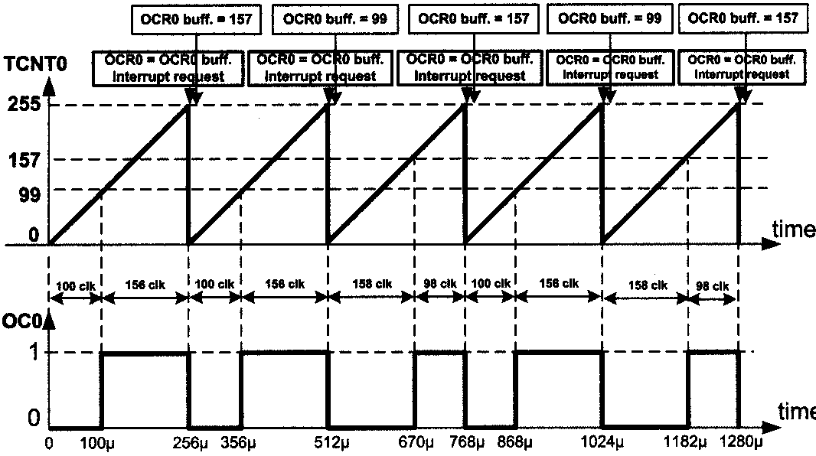
PWM PROGRAMMING AND DC MOTOR CONTROL IN AVR SECTION 16.2: PWM MODES IN 8-BIT TIMERS

Slide 43
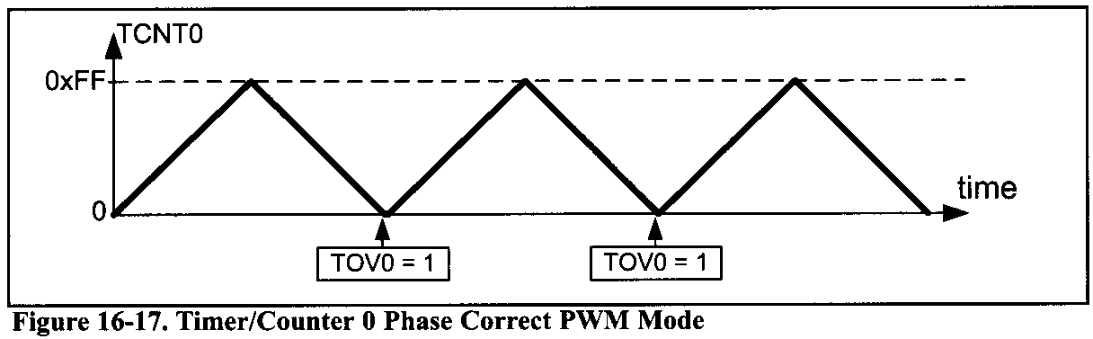
PWM PROGRAMMING AND DC MOTOR CONTROL IN AVR SECTION 16.2: PWM MODES IN 8-BIT TIMERS
Phase correct PWM mode programming of timer0
In the Phase correct PWM, the TCNT0 goes up and down like a yo-yo! First it counts up until it reaches the top value. Then it counts down until it reaches zero. The TOV0 flag is set whenever it reaches zero.

Slide 44
PWM PROGRAMMING AND DC MOTOR CONTROL IN AVR SECTION 16.2: PWM MODES IN 8-BIT TIMERS

Slide 45
PWM PROGRAMMING AND DC MOTOR CONTROL IN AVR SECTION 16.2: PWM MODES IN 8-BIT TIMERS

Slide 46
PWM PROGRAMMING AND DC MOTOR CONTROL IN AVR SECTION 16.2: PWM MODES IN 8-BIT TIMERS
DC motors

Slide 47
PWM PROGRAMMING AND DC MOTOR CONTROL IN AVR SECTION 16.2: PWM MODES IN 8-BIT TIMERS

Slide 48
PWM PROGRAMMING AND DC MOTOR CONTROL IN AVR SECTION 16.2: PWM MODES IN 8-BIT TIMERS
So the duty cycle can be calculated using formula in non-inverted mode:

Slide 49
PWM PROGRAMMING AND DC MOTOR CONTROL IN AVR SECTION 16.2: PWM MODES IN 8-BIT TIMERS
Example 16-12
Find the value for TCCR0 for Phase correct PWM, non-inverted PWM wave generator, and no prescaler.
Solution:
WGM01:00=01= Phase correct PWM mode
COM01:00=10= Non-inverted PWM
CS02:00=001=No prescaler

Slide 50
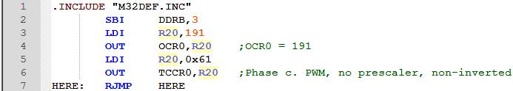
PWM PROGRAMMING AND DC MOTOR CONTROL IN AVR SECTION 16.2: PWM MODES IN 8-BIT TIMERS
Example 16-13
Assuming XTAL = 8 MHz, using non-inverted mode, write a program that generates a wave with frequency of 15,686 Hz and duty cycle of 75%.
Solution:
15,686=8M/(510×N) ⇒ N=8M/(15,626×510)=1 ⇒ Noprescaler
75=OCR0×100/255 ⇒ OCR0=75×255/100=191 ⇒ OCR0=191

Slide 51
PWM PROGRAMMING AND DC MOTOR CONTROL IN AVR SECTION 16.2: PWM MODES IN 8-BIT TIMERS
Example 16-14
Find the value for TCCRO for Phase correct PWM, inverted PWM wave generator, and prescaler = 256.
Solution:
WGM01:00 = 01 = Phase correct PWM mode
COM01:00 = 11 = Inverted PWM
CS02:00 = 100 = Scale 256

Slide 52
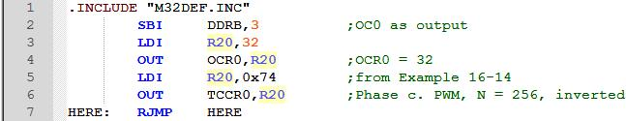
PWM PROGRAMMING AND DC MOTOR CONTROL IN AVR SECTION 16.2: PWM MODES IN 8-BIT TIMERS
Example 16-15
Assuming XTAL = 8 MHz, using inverted mode, write a program that generates a wave with frequency of 61 Hz and duty cycle of 87.5%.
Solution:
61=8M/(510 x N) ⇒ N=8M/(61×510)= 256 87.5= 100 x (255–OCR0)/255 ⇒ 255–OCR0=(255×87.5)/100=223 ⇒ OCR0=32

Slide 53
PWM PROGRAMMING AND DC MOTOR CONTROL IN AVR SECTION 16.2: PWM MODES IN 8-BIT TIMERS
Difference between the wave generated by phase correct PWM and Fast PWM
In non-inverted Fast PWM, the duty cycle of the generated wave is (OCR0 +1)/256. Because the value of OCR0 is between 0 and 255, the duty cycle of the wave can be changed between 1/256 and 256/256. Therefore, in non-inverted Fast PWM the duty cycle of wave cannot be 0% (unless we turn off the wave-form generator).
Similarly, in inverted Fast PWM, the duty cycle changes between 0/256 and 255/256; thus, the duty cycle cannot be 100%. But in Phase correct PWM, the duty cycle changes between 0/255 and 255/255. Therefore, the wave can change between 0% (completely off) and 100% (completely on).

Slide 54
PWM PROGRAMMING AND DC MOTOR CONTROL IN AVR SECTION 16.2: PWM MODES IN 8-BIT TIMERS

Slide 55
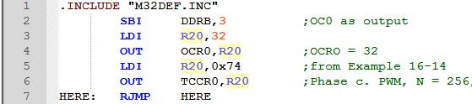
PWM PROGRAMMING AND DC MOTOR CONTROL IN AVR SECTION 16.2: PWM MODES IN 8-BIT TIMERS
Generating waves using Timer2
Timer2 is an 8-bit timer. Therefore, it works similar to Timer0. the differences are register names, output port, and the prescaler values of TCCRn register.
Example 16-15
Assuming XTAL = 8 MHz, using inverted mode, write a program that generates a wave with frequency of 61 Hz and duty cycle of 87.5%.
Solution:
61=8M/(510×N) ⇒ N=8M/(61×510) 256 87.5 = 100×(255-OCR0)/255 ⇒ 255-OCR0=(255×87.5)/100=223 ⇒ OCR0=32

Slide 56
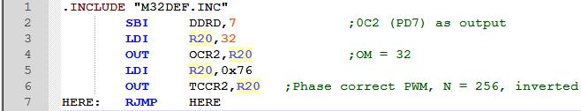
PWM PROGRAMMING AND DC MOTOR CONTROL IN AVR SECTION 16.2: PWM MODES IN 8-BIT TIMERS
Generating waves using Timer2
Timer2 is an 8-bit timer. Therefore, it works similar to Timer0. the differences are register names, output port, and the prescaler values of TCCRn register
Example 16-16
Rewrite Example 16-15 using Timer2.
Solution:
According to Figure 9-11, the TCCR2 register should be loaded with:

Slide 57
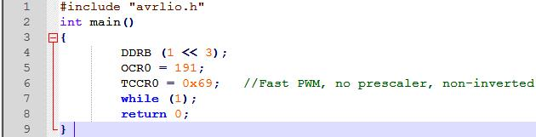
PWM PROGRAMMING AND DC MOTOR CONTROL IN AVR SECTION 16.2: PWM MODES IN 8-BIT TIMERS
8-bit programming in C
Example 16-17 (C version of Example 16-8)
Rewrite the program of Example 16-8 using C.
Solution:

Slide 58
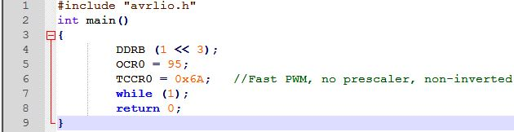
PWM PROGRAMMING AND DC MOTOR CONTROL IN AVR SECTION 16.2: PWM MODES IN 8-BIT TIMERS
Example 16-18 (C version of Example 16-9)
Rewrite the program of Example 16-9 using C.
Solution:

Slide 59
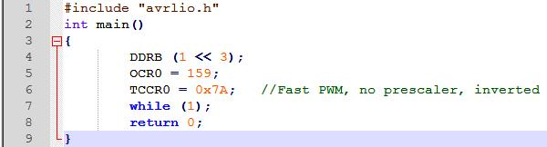
PWM PROGRAMMING AND DC MOTOR CONTROL IN AVR SECTION 16.2: PWM MODES IN 8-BIT TIMERS
Example 16-19 (C version of Example 16-10)
Rewrite the program of Example 16-10 using C.
Solution:

Slide 60
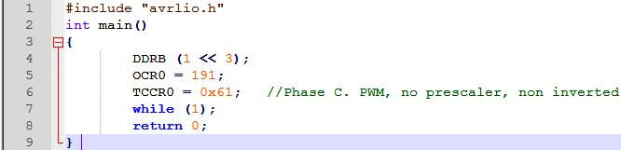
PWM PROGRAMMING AND DC MOTOR CONTROL IN AVR SECTION 16.2: PWM MODES IN 8-BIT TIMERS
Example 16-20 (C version of Example 16-13)
Rewrite the program of Example 16-13 using C.
Solution:

Slide 61

PWM PROGRAMMING AND DC MOTOR CONTROL IN AVR SECTION 16.2: PWM MODES IN 8-BIT TIMERS
Example 16-21 (C version of Example 16-15)
Rewrite the program of Example 16-15 using C.
Solution:

Slide 62
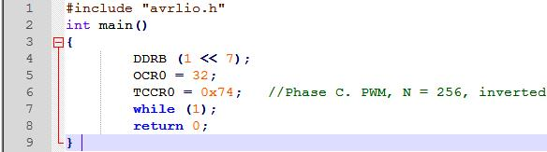
PWM PROGRAMMING AND DC MOTOR CONTROL IN AVR SECTION 16.2: PWM MODES IN 8-BIT TIMERS
Example 16-22 (C version of Example 16-16)
Rewrite the program of Example 16-16 using C.
Solution:

Slide 63
PWM PROGRAMMING AND DC MOTOR CONTROL IN AVR SECTION 16.3: PWM MODES IN TIMER1
Fast PWM Mode

Slide 64
PWM PROGRAMMING AND DC MOTOR CONTROL IN AVR SECTION 16.3: PWM MODES IN TIMER1
Fast PWM Mode
We know that we have five Fast PWM modes in Timer1: modes 5, 6, 7, 14, and 15. In mode 5, 6, and 7 the top value is fixed at 0xFF, 0x1FF, and 0x3FF;
TOV1 flag in the timer rolls over

Slide 65
PWM PROGRAMMING AND DC MOTOR CONTROL IN AVR SECTION 16.3: PWM MODES IN TIMER1
While in modes 14 and 15, the ICR1 and OCR1A registers represent the top value

Slide 66
PWM PROGRAMMING AND DC MOTOR CONTROL IN AVR SECTION 16.3: PWM MODES IN TIMER1
DC motors

Slide 67
PWM PROGRAMMING AND DC MOTOR CONTROL IN AVR SECTION 16.3: PWM MODES IN TIMER1
In Figure 16-31 you see the reaction of the waveform generator when compare match occurs whie the timer is in Fast PWN mode.
When COM1A1:0 = 00 the OC1A pin operates as an I/O port.
When COM1A1:0 = 10 the waveform generator clears the OC1A pin whenever compare match occurs, and sets it at the top value.
This mode is called non-inverted PWM.

Slide 68
PWM PROGRAMMING AND DC MOTOR CONTROL IN AVR SECTION 16.3: PWM MODES IN TIMER1
When COM1A1:0 = 11, the waveform generator sets the OC1A pin whenever compare match occurs, and clears it at the top value. This mose is refered to as inverted PWM mode. The duty cycle of the generated wave decreases when the value of OCR1A increases.
The same thing is true about the OCR1B register and COM1B1:0 bits.

Slide 69
PWM PROGRAMMING AND DC MOTOR CONTROL IN AVR SECTION 16.3: PWM MODES IN TIMER1
Frequency of the generated wave in Fast PWM mode
In Fast PWM mode, timer counts from 0 to top value and then rolls over. Thus, the frequency of generated wave is 1/(Top+1) of frequency of timer clock. (N is determined by the prescaler)

Slide 70
PWM PROGRAMMING AND DC MOTOR CONTROL IN AVR SECTION 16.3: PWM MODES IN TIMER1
Duty cycle of the generated wave in Fast PWM mode
Duty cycle of the generated mode can be determined using OCR1x register. When COM1x1:0 = 10 (in non-inverting mode), the bigger OCR1x value results in a bigger duty cycle. When OCR1x = Top, the OC1 is always high (duty cycle = 100%). Generally speaking the OC1x is high for a total of OCR1x + 1 clocks.
In inverted mode, the duty cycle can be calculated using the following formula:

Slide 71
PWM PROGRAMMING AND DC MOTOR CONTROL IN AVR SECTION 16.3: PWM MODES IN TIMER1
Example 16-23
Calculate the value for the OCRIB register to generate a wave with duty cycle of 75% for each of the following modes:
Mode 5, non-inverted mode
Mode 7, inverted mode
Mode 6, non-inverted mode
Mode 5, inverted mode
Mode 7, non-inverted mode

Slide 72
PWM PROGRAMMING AND DC MOTOR CONTROL IN AVR SECTION 16.3: PWM MODES IN TIMER1
Example 16-23 (Cont.)
Solution:
In mode 5, Top=0xFF=255. Thus, 75 = (OCRlx + 1)×100/(Top+1) ⇒ OCR1x + 1 = 75×256/100 =192 ⇒ OCR1B = 191
In mode 7, Top=0x3FF =1023. Thus, 75 = (Top-OCR1x)×100/(Top+1) ⇒ 1023-OCRlx= 75×1024/100 = 768 ⇒ OCR1B = 255
In mode 6, Top=0x1FF = 511. Thus, 75 = (OCRlx + 1×100/(Top+1) ⇒ OCRlx+1=75×512/100= 38 ⇒ OCR1A = 383
In mode 5, Top=0xFF=255. Thus, 75=(Top - OCR1x)×100/(Top + 1) ⇒ 75=(255-OCR1x)×100/256 ⇒255-OCRlx=75×256/100=192 ⇒OCRIB = 255-192 = 63
In mode 7, Top=0x3FF = 1023. Thus, 75 = (OCRlx+1)×100/(Top+1)⇒ OCRlx+1=75 ×1024/100=768 ⇒ OCR1B = 767

Slide 73
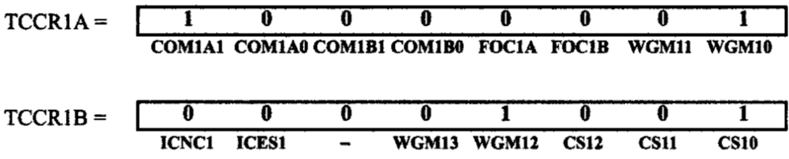
PWM PROGRAMMING AND DC MOTOR CONTROL IN AVR SECTION 16.3: PWM MODES IN TIMER1
Example 16-24
Find the values for TCCR1A and TCCR1B to initialize Timer1 for mode 5 (Fast PWM mode, top = 0xFF), non-inverted PWM wave generator, and no prescaler, using wave-form generator A.
Solution:
WGM13:10 = 0101 = Fast PWM mode
CS02:00 = 001 = No prescaler
COM01:00 = 10 = Non-inverted PWM

Slide 74
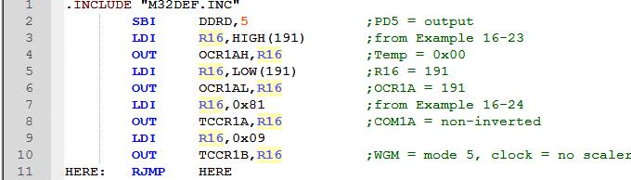
PWM PROGRAMMING AND DC MOTOR CONTROL IN AVR SECTION 16.3: PWM MODES IN TIMER1
Example 16-25
Assuming XTAL = 8 MHz, using non-inverted mode, and mode 5, write a program that generates a wave with frequency of 31,250 Hz and duty cycle of 75%.
Solution:
31,250 = 8M / (256 × N) ⇒ N = 8M / (31,250 × 256) = 1 ⇒ No prescaler

Slide 75
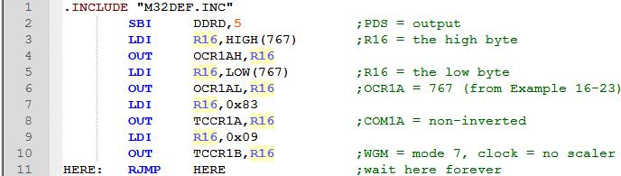
PWM PROGRAMMING AND DC MOTOR CONTROL IN AVR SECTION 16.3: PWM MODES IN TIMER1
Example 16-26
Assuming XTAL = 8 MHz, using non-inverted mode, and mode 7, write a program that generates a wave with frequency of 7812.5 Hz and duty cycle of 75%.
Solution:
7812.5 = 8M / (1024 × N) ⇒ N = 8M / (7812.5 × 1024) = 1 ⇒ No prescaler

Slide 76
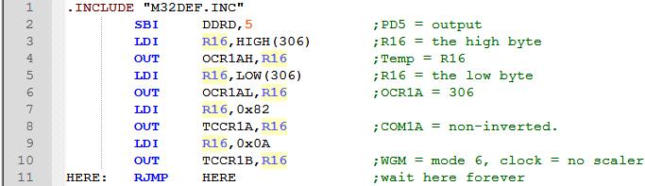
PWM PROGRAMMING AND DC MOTOR CONTROL IN AVR SECTION 16.3: PWM MODES IN TIMER1
Example 16-27
Assuming XTAL = 8 MHz, using non-inverted mode and mode 6, write a program that generates a wave with frequency of 1,953 Hz and duty cycle of 60%.
Solution:
In mode 6, Top=0x1FF=511. Thus,
60=(OCRlx+1)×100/(Top + 1) ⇒ OCRlx + 1 = 60×512/100=307 ⇒ OCR1B=306
1953=8M/(512×N) ⇒ N=8M/(1953×512)=8 ⇒ prescaler=1:8 ⇒ CS12:0 = 010

Slide 77
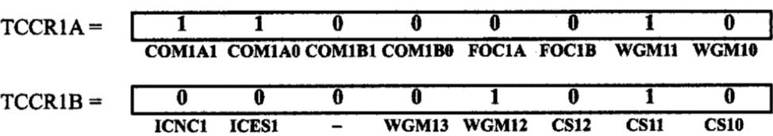
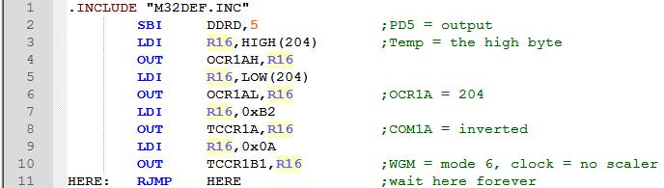
PWM PROGRAMMING AND DC MOTOR CONTROL IN AVR SECTION 16.3: PWM MODES IN TIMER1
Example 16-28
Rewrite Example 16-27 using inverted mode.
Solution:
60=(Top-OCR1x)×100/(Top + 1). ⇒ 511-OCRlx=60×512/100=307 ⇒ OCR1B = 511 -307 = 204

Slide 78
PWM PROGRAMMING AND DC MOTOR CONTROL IN AVR SECTION 16.3: PWM MODES IN TIMER1
Loading values into the OCR1A and OCR1B registers in PWM modes
In the non-PWM modes (CTC mode and Normal mode), when we load a value into the OCR1x register, the value will be loaded instantly, but in the PWM modes, there is a buffer between us and OCR1A and OCR1B registers. When we read/write a value from/into the OCR1A or OCR1B register we are dealing with the buffer. The contents of the buffer will be loaded into the OCR1A/OCR1B registers only when the TCNT1 reaches its topmost value.

Slide 79
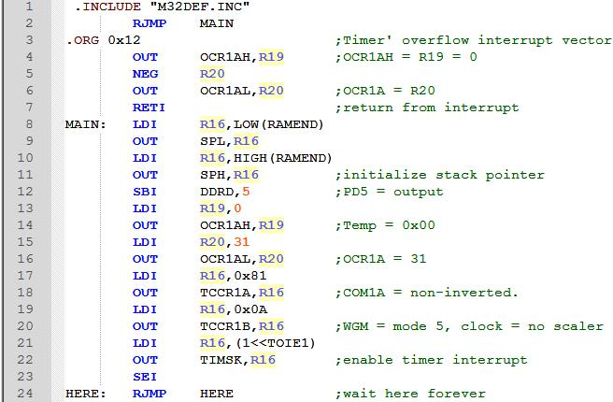
PWM PROGRAMMING AND DC MOTOR CONTROL IN AVR SECTION 16.3: PWM MODES IN TIMER1
Example 16-29
Draw the wave generated by the following program. Assume XTAL = 1 MHz.

Slide 80
PWM PROGRAMMING AND DC MOTOR CONTROL IN AVR SECTION 16.3: PWM MODES IN TIMER1
DC motors

Slide 81
PWM PROGRAMMING AND DC MOTOR CONTROL IN AVR SECTION 16.3: PWM MODES IN TIMER1
Generating waves with different frequencies (case study)
As we mentioned earlier, the frequency of the generated wave is equal to F_{oscillator} /[N*(Top + 1)]. In the modes 5, 6, and 7, the Top value is fixed. Therefore, in these modes the only way to change the frequency of the generated wave is to change N. In following figure you see the different frequencies that can be generated using modes 5,6, and 7.

Slide 82
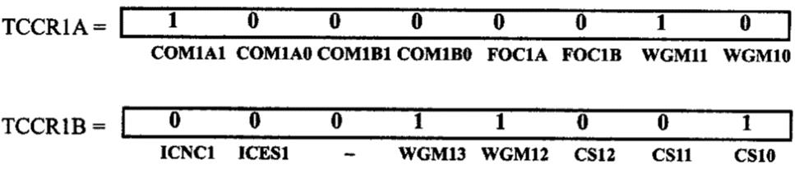
PWM PROGRAMMING AND DC MOTOR CONTROL IN AVR SECTION 16.3: PWM MODES IN TIMER1
Thus in these modes we can make a very limited number of frequencies. In modes 14 and 15 the Top value can be specified by ICR1 and OCR1A registers.
Example 16-30
Assuming XTAL = 8 MHz, find TCCR1A and TCCR1B to generate a wave with frequency of 80 kHz using mode 14.
Solution:
80K=8M/[N×(Top + 1)] ⇒ N×(Top + 1)=8M/80K=100
N× (Top + 1) = 100 ⇒ N = 1; Top + 1 = 100
Top = 99 ⇒ ICR1 = 99
N= 1 ⇒ CS12:0 = 001

Slide 83
PWM PROGRAMMING AND DC MOTOR CONTROL IN AVR SECTION 16.3: PWM MODES IN TIMER1
Example 16-31
Calculate the OCR1B to generate a wave with duty cycle of 20% in each of the following modes:
mode 14, inverted mode, ICR1 = 45,
mode 15, non-inverted mode, OCR1A = 124, and
mode 14, non-inverted mode, ICR1 = 99.
Solution:

Slide 84
PWM PROGRAMMING AND DC MOTOR CONTROL IN AVR SECTION 16.3: PWM MODES IN TIMER1
Solution:
In mode 14, Top = ICR1 = 45. Thus,
20 = (Top - OCR1x)×100/(Top + 1) ⇒ 45 - OCRlx = 20 × 46 / 100 = 9 ⇒ OCR1A = 36
(b) In mode 15, Top = OCR = 124. Thus,
20 =(OCR1x + 1) ×100/(124 + 1). ⇒ OCR1x + 1 = 20 × 125 / 100 =25 ⇒ OCR1x = 24
In mode 14, Top = ICR1 = 99. Therefore,
20 = (OCR1x + 1) × 100 / (99 + 1) ⇒ OCR1x + 1 =20 ⇒ OCR1x = 19

Slide 85

PWM PROGRAMMING AND DC MOTOR CONTROL IN AVR SECTION 16.3: PWM MODES IN TIMER1
Example 16-32
Assume XTAL = 8 MHz. Using mode 14 write a program that generates a wave with duty cycle of 20% and frequency of 80 kHz.
Solution:

Slide 86
PWM PROGRAMMING AND DC MOTOR CONTROL IN AVR SECTION 16.3: PWM MODES IN TIMER1
Phase correct PWM Mode
In the phase correct PWM, the timer counts up until it reaches the top value then counts down until it reaches zero. The TOV1 flag will be set when the timer returns to zero,
There are five phase correct PWM modes: modes 1,2,3,10, and 11

Slide 87
PWM PROGRAMMING AND DC MOTOR CONTROL IN AVR SECTION 16.3: PWM MODES IN TIMER1
Phase correct PWM Mode

Slide 88
PWM PROGRAMMING AND DC MOTOR CONTROL IN AVR SECTION 16.3: PWM MODES IN TIMER1
Phase correct PWM Mode
In modes 1, 2, and 3 the top values are 0xFF, 0x1FF, and 0x3FF. In mode 10, the top value is defined by the ICR1 register; and in mode 11, the OCR1A register represents the top value.

Slide 89
PWM PROGRAMMING AND DC MOTOR CONTROL IN AVR SECTION 16.3: PWM MODES IN TIMER1
Phase correct PWM Mode

Slide 90
PWM PROGRAMMING AND DC MOTOR CONTROL IN AVR SECTION 16.3: PWM MODES IN TIMER1
Phase correct PWM Mode

Slide 91
PWM PROGRAMMING AND DC MOTOR CONTROL IN AVR SECTION 16.3: PWM MODES IN TIMER1
Frequency of generated wave in phase correct PWM mode
The frequency of generated wave is 1/2TOP of the frequency of timer clock. The 8-bit timers the frequency of the generated wave can be calculated as follows:

Slide 92
PWM PROGRAMMING AND DC MOTOR CONTROL IN AVR SECTION 16.3: PWM MODES IN TIMER1
Phase correct PWM Mode

Slide 93
PWM PROGRAMMING AND DC MOTOR CONTROL IN AVR SECTION 16.3: PWM MODES IN TIMER1
Duty cycle of the generated wave in Phase correct PWM mode
The duty cycle of the generated mode can be determined using OCR1x register. When COM1x1:0 = 10 (in non-inverted mode), the bigger OCR1x value results in a bigger duty cycle. When OCR1x = Top, the OC1x is always high (duty cycle = 100%). Generally speaking, OC1x is high for a total of OCR1x clocks.
So the duty cycle can be calculated using the following formula in non-inverted mod:

Slide 94

PWM PROGRAMMING AND DC MOTOR CONTROL IN AVR SECTION 16.3: PWM MODES IN TIMER1
Example 16-35
Find the values for TCCR1A and TCCR1B to initialize Timer1 for mode 1 (Phase correct PWM mode, top = 0xFF), non-inverted PWM wave generator, and no prescaler.
Solution:
WGM13:10 = 0001 = Phase correct PWM mode
CS02:00 = 001 = No prescaler
COM01:00 = 10 = Non-inverted PWM

Slide 95
PWM PROGRAMMING AND DC MOTOR CONTROL IN AVR SECTION 16.3: PWM MODES IN TIMER1
Example 16-36
Calculate the OCR1B to generate a wave with duty cycle of 75% in each of the following modes:
Mode 1, non-inverted mode
Mode 3, inverted mode
Mode 2, non-inverted mode
Mode 2, inverted mode
Mode 1, inverted mode
Solution:
In mode 1, Top = 0xFF= 255. So,
75=OCR1x×100/Top ⇒ OCR1x=75×255/100=192
⇒ OCR1B = 191

Slide 96
PWM PROGRAMMING AND DC MOTOR CONTROL IN AVR SECTION 16.3: PWM MODES IN TIMER1
Solution:
In mode 3, Top=0x3FF=1023. So,
75 = (Top-OCR1x)×100/Top ⇒ 1023-OCRlx = 75 × 1023 / 100 = 767 ⇒ OCR1B = 255
In mode 2, Top = 0x1FF = 511. So,
75 = OCR1x×100/Top+OCR1x=75×511/100=383
⇒ OCR1B = 383
In mode 2, Top=0x1FF=511. So,
75=(Top-OCR1x)×100/Top ⇒ 75=(511-OCR1x)×100/511 ⇒
511–OCR1x = 75×511/100-383 ⇒ OCR1B = 511-383=128
(e) In mode 1, Top=0xFF=255. So,
75-(Top-OCR1x)×100/Top ⇒ 75=(255-OCR1x)×100/255 ⇒
255–OCR1x= 75×255/100=191 ⇒ OCR1B=255-191=64

Slide 97

PWM PROGRAMMING AND DC MOTOR CONTROL IN AVR SECTION 16.3: PWM MODES IN TIMER1
Example 16-37
Assuming XTAL = 8 MHz, using non-inverted mode and mode 1, write a program that generates a wave with frequency of 15,686 Hz and duty cycle of 75%.
Solution:
15,686=8M/(510×N) ⇒ N=8M/(15,686×510)=1 ⇒ No prescaler

Slide 98
PWM PROGRAMMING AND DC MOTOR CONTROL IN AVR SECTION 16.3: PWM MODES IN TIMER1
Generating waves with different frequencies (case study)
As mentioned earlier, the frequency of generated wave is equal to F_{oscillator}/(2N*Top). In modes 1, 2, and 3, the top value is fixed. Therefore, in these modes the only way to change the frequency of generated wave is to change N. Now you can see the different frequencies that can be generated using modes 1, 2, and 3.

Slide 99
PWM PROGRAMMING AND DC MOTOR CONTROL IN AVR SECTION 16.3: PWM MODES IN TIMER1
So, in these modes we can make a very limited number of frequencies. In modes 10, 11, the Top value can be specified by ICR1 and the OCR1A registers. Thus we can change the frequency by loading proper values to ICR1 and OCR1A.
Example 16-38
Assuming XTAL = 8 MHz, find TCCR1A and TCCR1B to generate two waves with frequency of 125 Hz on OC1A and 0C1B using mode 10, non-inverted mode, and prescaler = 1:256.
Solution:
125=8M/(2N×Top). 2N×Top=8M/125 = 64,000 ⇒ Top = 64,000 / 512 = 250
Top = 250 ⇒ ICR1 = 250
N=256 ⇒ CS12:0=100
Mode = 10 ⇒ WGMI2:10=1010
OC1A in non-inverted mode ⇒ COM1A1:COM1A0=10
OC1B in non-inverted mode ⇒ COM1B1:COM1B0=10

Slide 100
PWM PROGRAMMING AND DC MOTOR CONTROL IN AVR SECTION 16.3: PWM MODES IN TIMER1
Example 16-39
Calculate the OCR1x to generate the following waves in each of the following modes:
(a) Mode 11, inverted mode, OCR1A=50, duty cycle = 30%
(b) Mode 10, non-inverted mode, ICR1 = 250, duty cycle = 30%
(c) Mode 10, non-inverted mode, ICR1 = 250, duty cycle = 60%
Solution:
(a) In mode 11, Top=OCR1A=50. So,
30 = (Top OCR1B)×100/Top ⇒ 50-OCR1B=50×30/100=15⇒ OCR1B = 35
(b) In mode 10, Top = ICR1 = 250. So,
30=OCR1x×100/Top ⇒ OCR1x = 30×250/100=75 ⇒ OCR1x = 75
(c) In mode 10, Top = ICR1 = 250. So,
60=OCR1x×100/ Top ⇒ OCR1x = 60×250/100 ⇒ OCR1x = 150

Slide 101

PWM PROGRAMMING AND DC MOTOR CONTROL IN AVR SECTION 16.3: PWM MODES IN TIMER1
Example 16-40
Assume XTAL = 8 MHz. Using mode 10 write a program that generates waves with duty cycles of 30% and 60% on the OC1A and 0C1B pins, respectively. Frequency of the generated waves should be 125 Hz.
Solution:

Slide 102

PWM PROGRAMMING AND DC MOTOR CONTROL IN AVR SECTION 16.3: PWM MODES IN TIMER1
16-bit PWM programming in C
Example 16-41 (C version of Example 16-25)
Assuming XTAL = 8 MHz, using non-inverted mode and mode 5, write a program that generates a wave with frequency of 31,250 Hz and duty cycle of 75%.
Solution:

Slide 103

PWM PROGRAMMING AND DC MOTOR CONTROL IN AVR SECTION 16.3: PWM MODES IN TIMER1
16-bit PWM programming in C
Example 16-42 (C version of Example 16-26)
Assuming XTAL=8 MHz, using non-inverted mode and mode 7, write a program that generates a wave with frequency of 7812.5 Hz and duty cycle of 75%.
Solution:

Slide 104

PWM PROGRAMMING AND DC MOTOR CONTROL IN AVR SECTION 16.4: DC MOTOR CONTROL USING PWM
To generate the PWM waves for controlling the DC motor we can use the PWM feature of AVR.
Example 16-50 (Example 16-3 using AVR PWM features)
Refer to the figure in this example. Write a program to monitor the status of the switch and perform the following:
If PORTA.7 = 1, the DC motor moves with 25% duty cycle pulse.
If PORTA.7 = 0, the DC motor moves with 50% duty cycle pulse.

Slide 105
PWM PROGRAMMING AND DC MOTOR CONTROL IN AVR SECTION 16.4: DC MOTOR CONTROL USING PWM
Solution:
For driving motors it is preferable to use the Phase correct PWM mode. OCR0/255=duty cycle/100 ⇒ OCR0=255×duty cycle/100
For duty cycle = 25% ⇒ OCR0=255×25/100=64
For duty cycle = 50% ⇒ OCR0=255×50/100=127
In this example we generate waves with frequency of 245 Hz. To do so, 245=8M/(510×N) ⇒ N=8M/(245×510)=64
⇒ Prescaler = 64

Slide 106

PWM PROGRAMMING AND DC MOTOR CONTROL IN AVR SECTION 16.4: DC MOTOR CONTROL USING PWM

Slide 107

PWM PROGRAMMING AND DC MOTOR CONTROL IN AVR SECTION 16.4: DC MOTOR CONTROL USING PWM
Example 16-51
Write a program that gradually changes the speed of a DC motor from 50% to 100%. Use information given in Example 16-50.
Solution:

Slide 108

PWM PROGRAMMING AND DC MOTOR CONTROL IN AVR SECTION 16.4: DC MOTOR CONTROL USING PWM
DC motor control and PWM using C
Example 16-52 (C version of Example 16-50)
Write a program to monitor the status of the switch and perform the following: (a) If PORTA.7 = 1, the DC motor moves with 25% duty cycle pulse.
(b) If PORTA.7 = 0, the DC motor moves with 50% duty cycle pulse.
Solution:

Slide 109

PWM PROGRAMMING AND DC MOTOR CONTROL IN AVR SECTION 16.4: DC MOTOR CONTROL USING PWM
Phase correct PWM Mode
Example 16-53 (C version of Example 16-51)
Write a program that gradually changes the speed of a DC motor from 50% to 100%.
Solution:

